Slide 1
Chapter 6 Privacy and Surveillance

Slide 2
Table of Contents
Introduction to Information Privacy
Perspective on Privacy
Information Disclosures
Data Mining
Communication Technology and Eavesdropping
Data Protection

Slide 3
Introduction to Information Privacy
Information collection, exchange, combination, and distribution easier than ever means less privacy
Scott McNealy: “You have zero privacy anyway. Get over it.”
We will consider how we leave an “electronic trail” of information behind us and what others can do with this info

Slide 4
Perspective on Privacy

Slide 5
Perspective on Privacy
Privacy related to notion of access
Access
Physical proximity to a person
Knowledge about a person
Privacy is a “zone of inaccessibility”
Privacy violations are an affront to human dignity
Too much individual privacy can harm society
Where to draw the line?

Slide 6
Harms and Benefits of Privacy
Harms of Privacy
Cover for illegal or immoral activities
Burden on the nuclear family
Hidden dysfunctional families
Ignored people on society’s fringes

Slide 7
Harms and Benefits of Privacy
Benefits of Privacy
Individual growth
Individual responsibility
Freedom to be yourself
Intellectual and spiritual growth
Development of loving, trusting, caring, intimate relationships

Slide 8
Is There a Natural Right to Privacy?
Privacy rights stem from property rights: “a man’s home is his castle”
Samuel Warren and Louis Brandeis: People have “the right to be let alone”
Judith Jarvis Thomson: “Privacy rights” overlap other rights
Conclusion: Privacy is not a natural right, but it is a prudential right

Slide 9
Privacy and Trust
Perhaps modern life is actually more private than life centuries ago
Most people don’t live with extended families
Automobile allows us to travel alone
Television v. public entertainment
Challenge: we now live among strangers
Remedy: establishing reputations
Ordeal, such as lie detector test or drug test
Credential, such as driver’s license, key, ID card, college degree
Establishing reputation is done at the cost of reducing privacy

Slide 10
Case Study
Sullivans have a baby girl
Both work; they are concerned about performance of full-time nanny
Purchase program that allows monitoring through laptop’s camera placed in family room
They do not inform nanny she is being monitored
Is it wrong for Sullivan to secretly monitor the behavior of their baby’s nanny?

Slide 11
Case Study – Rule Utilitarian Evaluation
If everyone monitored nannies, it would not remain a secret for long
Consequences
Nannies would be on best behavior in front of camera
Might reduce child abuse and parents’ peace of mind
Would also increase stress and reduce job satisfaction of child care providers
Might result in higher turnover rate and less experienced pool of nannies, who would provide lower-quality care
Harms appear greater than benefits, so we conclude action was wrong

Slide 12
Case Study – Social Contract Theory Evaluation
It is reasonable for society to give people privacy in their own homes
Nanny has a reasonable expectation that her interactions with baby inside home are private
Sullivan’s decision to secretly monitor the nanny is wrong because it violates her privacy

Slide 13
Case Study – Kantian Evaluation
Imagine rule, “An employer may secretly monitor the work of an employee who works with vulnerable people”
If universalized, there would be no expectation of privacy by employees, so secret monitoring would be impossible
Proposed rule is self-defeating, so it is wrong for Sullivans to act according to the rule

Slide 14
Case Study – Summary
Three analyses have concluded Sullivans were wrong to secretly monitor how well their nanny takes care of their baby
Morally acceptable options
Conduct more comprehensive interview of nanny
More thoroughly check nanny’s references
Spend a day or two at home observing nanny from a distance
Be up-front with nanny about desire to install and use surveillance software on laptop

Slide 15
Information Disclosures

Slide 16
Information Disclosures
Public record: information about an incident or action reported to a government agency for purpose of informing the public
Examples: birth certificates, marriage licenses, motor vehicle records, criminal records, deeds to property
Computerized databases and Internet have made public records much easier to access

Slide 17
Information Disclosures
Records held by private organizations:
Credit card purchases
Purchases made with loyalty cards
Voluntary disclosures
Posts to social network sites

Slide 18
Information Disclosures
Data gathering and privacy implications:
Facebook tags
Enhanced 911 services
Rewards or loyalty programs
Body scanners
RFID tags
Implanted chips
OnStar
Automobile “black boxes”
Medical records
Digital video recorders
Cookies and flash cookies

Slide 19
Facebook Tags
Tag: Label identifying a person in a photo
Facebook allows users to tag people who are on their list of friends
About 100 million tags added per day in Facebook
Facebook uses facial recognition to suggest name of friend appearing in photo
Does this feature increase risk of improper tagging?

Slide 20
Enhanced 911 Services
Cell phone providers in United States required to track locations of active cell phones to within 100 meters
Allows emergency response teams to reach people in distress
What if this information is sold or shared?

Slide 21
Rewards or Loyalty Programs
Shoppers who belong to store’s rewards program can save money on many of their purchases
Computers use information about buying habits to provide personalized service
ShopRite computerized shopping carts with pop-up ads
Do card users pay less, or do non-users get overcharged?

Slide 22
Body Scanners
Some department stores have 3-D body scanners
Computer can use this information to recommend clothes
Scans can also be used to produce custom-made clothing

Slide 23
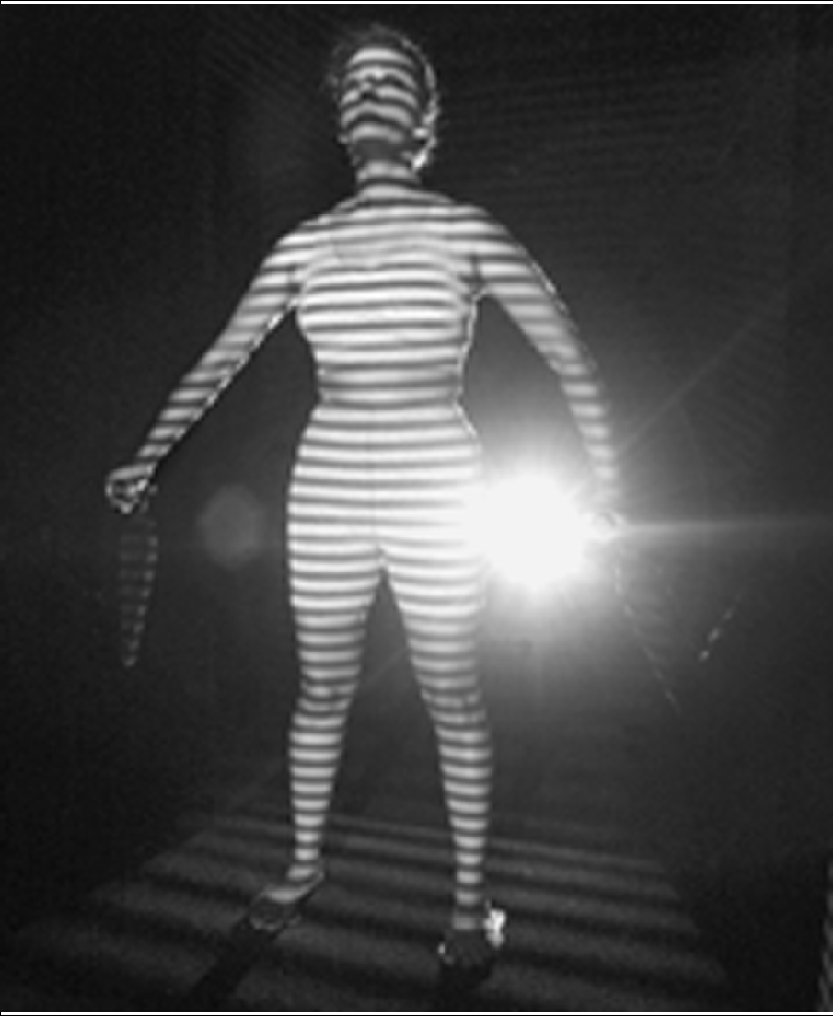
Body Scanners
AP Photo/Richard Drew

Slide 24
RFID Tags
RFID: Radio frequency identification
An RFID tag is a tiny wireless transmitter
Manufacturers are replacing bar codes with RFID tags
Contain more information
Can be scanned more easily
If tag cannot be removed or disabled, it becomes a tracking device

Slide 25
Implanted Chips
Taiwan: Every domesticated dog must have an implanted microchip
Size of a grain of rice; implanted into ear
Chip contains name, address of owner
Allows lost dogs to be returned to owners
RFID tags approved for use in humans
Can be used to store medical information
Can be used as a “debit card”

Slide 26
OnStar
OnStar manufactures communication system incorporated into rear-view mirror
Emergency, security, navigation, and diagnostics services provided subscribers
Two-way communication and GPS
Automatic communication when airbags deploy
Service center can even disable gas pedal

Slide 27
Automobile “Black Boxes”
Modern automobiles come equipped with a “black box”
Maintains data for five seconds:
Speed of car
Amount of pressure being put on brake pedal
Seat belt status
After an accident, investigators can retrieve and gather information from “black box”

Slide 28
Medical Records
Advantages of changing from paper-based to electronic medical records
Quicker and cheaper for information to be shared among caregivers
Lower medical costs
Improve quality of medical care
Once information in a database, more difficult to control how it is disseminated

Slide 29
Digital Video Recorders
TiVo service allows subscribers to record programs and watch them later
TiVo collects detailed information about viewing habits of its subscribers
Data collected second by second, making it valuable to advertisers and others interested in knowing viewing habits

Slide 30
Cookies and Flash Cookies
Cookie: File placed on computer’s hard drive by a Web server
Contains information about visits to a Web site
Allows Web sites to provide personalized services
Put on hard drive without user’s permission
You can set Web browser to alert you to new cookies or to block cookies entirely

Slide 31
Cookies and Flash Cookies
Flash cookie: File placed on your computer’s hard drive by a Web server running the Adobe Flash Player
Flash cookie can hold 25 times as much information as a browser cookie
Flash cookies not controlled by browser’s privacy controls
Some Web sites use flash cookies as a way of backing up browser cookies. If you delete browser cookie, it can be “respawned” from the flash cookie
Half of 100 most popular Web sites use flash cookies

Slide 32
Data Mining

Slide 33
Data Mining
Searching records in one or more databases, looking for patterns or relationships
Can be used to profiles of individuals
Allows companies to build more personal relationships with customers

Slide 34
Data Mining
Google’s Personalized Search:
Secondary use: Information collected for one purpose use for another purpose
Google keeps track of your search queries and Web pages you have visited
It uses this information to infer your interests and determine which pages to return
Example: “bass” could refer to fishing or music
Also used by retailers for direct marketing

Slide 35
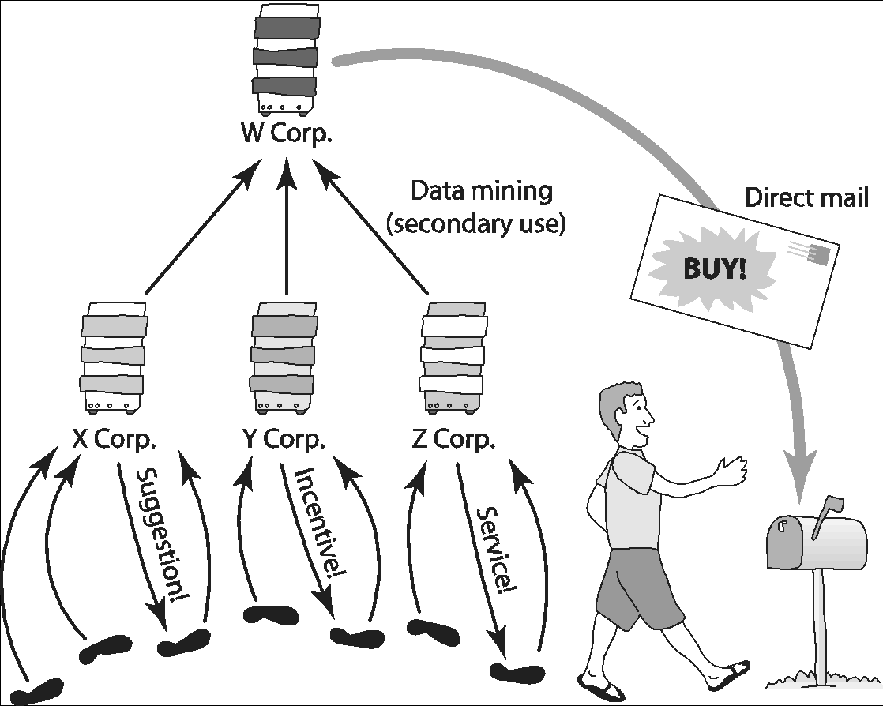
Data Mining
Secondary uses of information

Slide 36
Opt-in Versus Op-out Policies
Who controls transaction information?
Buyer?
Seller?
Both?
Opt-in: Consumer must explicitly give permission before the organization can share info
Opt-out: Organization can share info until consumer explicitly forbid it
Opt-in is a barrier for new businesses, so direct marketing organizations prefer opt-out

Slide 37
Examples of Data Mining – Credit Reports
Example of how information about customers can itself become a commodity
Credit bureaus
Keep track of an individual’s assets, debts, and history of paying bills and repaying loans
Sell credit reports to banks, credit card companies, and other potential lenders
System gives you more choices in where to borrow money
Poor credit can hurt employment prospects

Slide 38
Examples of Data Mining – Microtargeting
Political campaigns determine voters most likely to support particular candidates
Voter registration
Voting frequency
Consumer data
GIS data
Target direct mailings, emails, text messages, home visits to most likely supporters

Slide 39
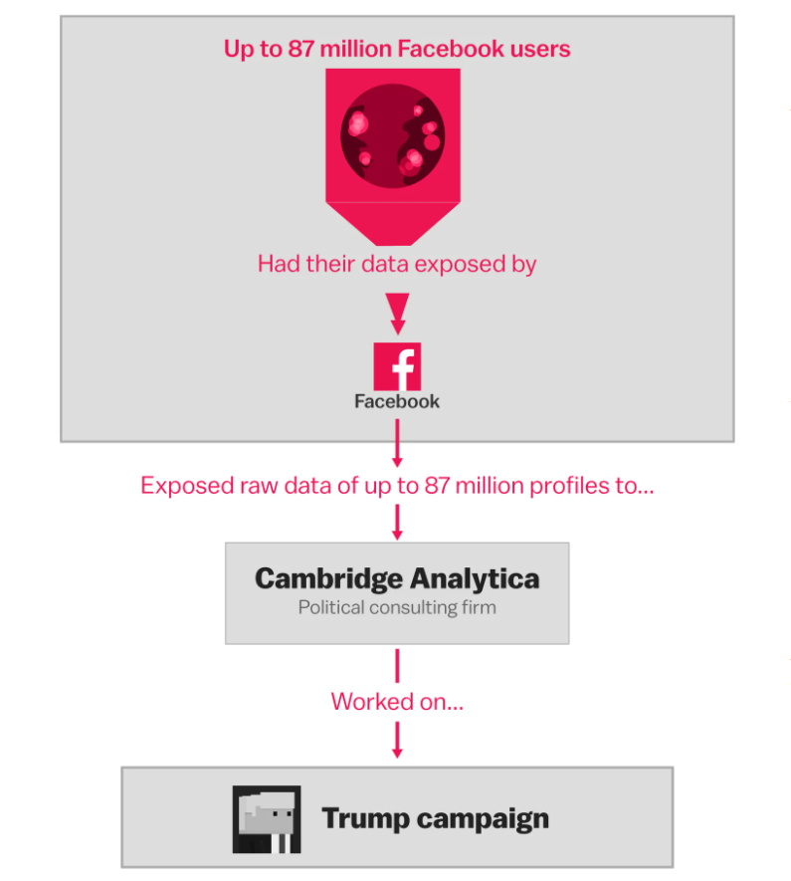
The Facebook and Cambridge Analytica scandal
Source: https://www.vox.com/policy-and-politics/2018/3/23/17151916/facebook-cambridge-analytica-trump-diagram

Slide 40
Organizations Push the Boundaries
Marketplace: Households
Lotus Development Corporation developed CD with information on 120 million Americans
Planned to sell CD to small businesses that wanted to create mailing lists based on various criteria, such as household income
More than 30,000 consumers complained to Lotus about invasion of privacy
Lotus dropped plans to sell CD

Slide 41
Organizations Push the Boundaries
Facebook Beacon:
Fandango, eBay, and 42 other online businesses paid Facebook to do “word of mouth” advertising
Facebook users surprised to learn information about their purchases was shared with friends
Beacon was based on an opt-out policy
Beacon strongly criticized by various groups
Facebook switched to an opt-in policy regarding Beacon

Slide 42
Organizations Push the Boundaries
Netflix Prize:
Netflix offered $1 million prize to any group that could come up with a significantly better algorithm for predicting user ratings
Released more than 100 million movie ratings from a half million customers
Stripped ratings of private information
Researchers demonstrated that ratings not truly anonymous if a little more information from individuals was available
U.S. Federal Trade Commission complaint and lawsuit
Netflix canceled sequel to Netflix Prize

Slide 43
Social Network Analysis
Data mining now incorporating information collected from social networks
Examples
Cell phone companies in India identify “influencers”
Police predict locations of big parties
Banks evaluate the riskiness of loans

Slide 44
Communication Technology and Eavesdropping
Ways to Eavesdrop
Identity of Eavesdropper
Legality of Eavesdropping
The Whole Is Greater than the Sum of its Parts

Slide 45
Ways to Eavesdrop
This section will consider major forms of communication, how to eavesdrop on them and possible ways to foil eavesdropping

Slide 46
Ways to Eavesdrop – Direct Speech
simplest form of communication - speak directly to the person with whom you wish to communicate, while within their hearing
to eavesdrop, someone must be physically within hearing range or have a microphone and recorder or transmitter within the range of the voices

Slide 47
Ways to Eavesdrop – Direct Speech
Modern distance microphones can pick up conversations in the open and even via the vibrations made in window glass by the noise within a room.
Specialist scanning equipment can detect the radio signals of transmitters
To prevent eavesdropping, white-noise generators can mask sounds from microphones w/o interfering unduly with direct human hearing.

Slide 48
Ways to Eavesdrop – Written Communication
Various techniques exist for encoding or hiding the actual content of a message, including cryptographic and steganographic techniques
The most difficult-to-break cipher is a ‘one-time pad’ which is virtually unbreakable even with modern computers.
one-time pad (OTP) - encryption technique that cannot be cracked if used correctly
Notes:
one-time pad (OTP) Technique
plaintext paired with random, secret key (or pad).
each bit or character of the plaintext is encrypted by combining it with the corresponding bit or character from the pad using modular addition.
If the key is truly random, and at least as long as the plaintext, and never reused in whole or in part, and kept completelysecret, then the resulting ciphertext will be impossible to decrypt or break

Slide 49
Ways to Eavesdrop – Telephone
Line-switched so easier to “hack”
Now with VoIP, line switched voice communication is replaced by packet-switching
To send secret messages, governments uses machines for encrypting the signal to make it difficult to simply tap the line although this required both ends to be using a similar machine for the system to work.

Slide 50
Ways to Eavesdrop – E-Mail & Other Internet-Based Systems
Since the Internet is packet switched rather than line switched, monitoring Internet-based communications can be quite difficult
Why? End-to-end applications are used rather than server-hop-based systems such as the standard mail protocols

Slide 51
Ways to Eavesdrop – Mobile Telephones
Law enforcement officers have been worried by the expansion of mobile telephony and have placed great pressure on operators to ensure compatibility with eavesdropping techniques used by legal bodies
The encryption routines built into modern digital telephones do avoid some of the privacy problems with earlier analogue models, such as easy ‘phone cloning’ and eavesdropping by standard wireless communications scanners

Slide 52
Ways to Eavesdrop – Mobile Telephones
Phone cloning: copying the identification information for a mobile phone to allow diversion of text messages and calls made on that phone's account

Slide 53
Identity of Eavesdropper
Two types of eavesdropper: governmental and non-governmental
Governmental eavesdropping:
Regulated and legal
Non-governmental:
Restricted or completely banned in most countries
Exception: employers monitoring the employee’s use of Internet communication methods.
Example: in the United Kingdom, employers can monitor their employees' e-mail provided they tell their employees quite clearly that such monitoring is happening (they may not, however, monitor telephone use).

Slide 54
Legality of Eavesdropping
Wiretapping: tapping into telephone wires but now often used for any form of surveillance of electronic communication
Law is different in each country

Slide 55
Legality of Eavesdropping
The legality of law-enforcement agencies listening in to telephone conversations was first confirmed in US law in the Olmstead v United States case in 1928
The ruling in this case gave an open license to law-enforcement operatives to listen in (without a warrant) to the phone conversations of suspects provided they did not have to perform a physical trespass in order to do so.
Meaning: they could not enter a private residence without a warrant to place a radio bug and capture all conversations but they could attach a listening device to a telephone line at some point outside the property and listen to all the conversations.

Slide 56
Legality of Eavesdropping
This ruling was overturned in 1967 in Katz v United States which held that listening in on phone conversations without a warrant was generally not allowed.

Slide 57
Legality of Eavesdropping
The advent of computer-mediated communication created a problem for law-enforcement agencies seeking to eavesdrop
This has led to extended rights for law-enforcement agencies to monitor packet-switched information at its most vulnerable point, which is the ISP server.

Slide 58
Data Protection
Technology and markets
Rights and Laws
Data Protection Issues in EU Law
Data Protection Issues in US Regulation
Personal Data Protection Act 2010, Malaysia

Slide 59
Technology and Markets
Privacy enhancing-technologies for consumers
Encryption
Public-key cryptography
Business tools and policies for protecting data
Government ban on export of strong encryption software in the 1990s (removed in 2000)

Slide 60
Rights and Laws
Warren and Brandeis: The inviolate personality
Judith Jarvis Thomson: Is there a right to privacy?

Slide 61
Rights and Laws
Transactions
Ownership of personal data
A basic legal framework: Enforcement of agreements and contracts
Regulation

Slide 62
Rights and Laws
Contrasting Viewpoints
Free Market View
Freedom of consumers to make voluntary agreements
Diversity of individual tastes and values
Response of the market to consumer preferences
Usefulness of contracts
Flaws of regulatory solutions

Slide 63
Rights and Laws
Contrasting Viewpoints
Consumer Protection View
Uses of personal information
Costly and disruptive results of errors in databases
Ease with which personal information leaks out
Consumers need protection from their own lack of knowledge, judgment, or interest

Slide 64
Data Protection
There are two strands of data protection and privacy regulation in the Western world:
US approach - (self-regulation and market forces)
EU approach - (government regulation and strict laws)

Slide 65
Data Protection
EU approach
have long had stringent data protection legislation in force
Scandinavia, the regimes have always been very harsh and given a great deal of rights to the data subject, the person about whom data is held
opt-in explicit permission is required for any use of provided or garnered data
In other European countries, a slightly more free situation: holders of data were able to use it for a number of purposes but were required to meet certain standards, including accuracy and accountability

Slide 66
Data Protection
EU approach
The General Data Protection Regulation (GDPR) was drafted and passed by the European Union (EU).
The GDPR replaced the 1995 Data Protection Directive
GDPR imposes obligations onto organizations anywhere, so long as they target or collect data related to people in the EU.
Put into effect on May 25, 2018
The GDPR will levy harsh fines against those who violate its privacy and security standards

Slide 67
General Data Protection Regulation (GDPR)
legal terms under GDPR:
Personal data — Personal data is any information that relates to an individual who can be directly or indirectly identified. Names and email addresses are obviously personal data. Location information, ethnicity, gender, biometric data, religious beliefs, web cookies, and political opinions can also be personal data.
Data processing — Any action performed on data, whether automated or manual.
Data subject — The person whose data is processed.
Data controller — The person who decides why and how personal data will be processed.
Data processor — A third party that processes personal data on behalf of a data controller.
Extracted from https://gdpr.eu/what-is-gdpr/

Slide 68
General Data Protection Regulation (GDPR)
Data protection principles:
Lawfulness, fairness and transparency — Processing must be lawful, fair, and transparent to the data subject.
Purpose limitation — You must process data for the legitimate purposes specified explicitly to the data subject when you collected it.
Data minimization — You should collect and process only as much data as absolutely necessary for the purposes specified.
Accuracy — You must keep personal data accurate and up to date.
Storage limitation — You may only store personally identifying data for as long as necessary for the specified purpose.
Integrity and confidentiality — Processing must be done in such a way as to ensure appropriate security, integrity, and confidentiality (e.g. by using encryption).
Accountability — The data controller is responsible for being able to demonstrate GDPR compliance with all of these principles.
Extracted from https://gdpr.eu/what-is-gdpr/

Slide 69
Data Protection Issues in US Regulation
Different to that taken in European states
Uses market-driven approach
Federal Trade Commission (FTC www.ftc.gov) has general guidelines about appropriate privacy polices and enforces adherence to published policies.

Slide 70
Data Protection Issues in US Regulation
Concept: if data protection is important to consumers then they will use companies with the more protective regimes will ensue among commercial organizations to provide suitable protection
Different ways of handling personal data is a problem with data transfer (international movement of data) between EU and US
US Govt. - criticized for ignoring violations of policies, market monopolies

Slide 71
Personal Data Protection Act 2010, Malaysia
Malaysia has recently implemented its own version of the Personal Data Protection Act (PDPA) 2010.
This will have many implications for digital marketing companies

Slide 72
Personal Data Protection Act 2010, Malaysia
Anyone who breaches any of the above principles will be liable to a fine not exceeding MYR300,000 and / or a jail term not exceeding 2 years.
A data user is a person or persons who has control over or is able to authorize the processing of any personal data.

Slide 73
Personal Data Protection Act 2010, Malaysia
Malaysia’s Personal Data Protection Act (2010) comprises of the following principles:
General Principle
Notice and Choice Principle
Disclosure Principle
Security Principle
Retention Principle
Data Integrity Principle
Access Principle

Slide 74
Personal Data Protection Act 2010, Malaysia
General Principle
you’ll have to obtain the consent of an individual (E.g. Alicia) if you want to process that data.
Processing is necessary for the performance of a contract in which Alicia is a party
You need to process the data because Alicia is considering entering into a contract with you
To comply with any legal obligations in which Alicia is a subject
You need to protect Alicia’s vital interests
For the administration of justice

Slide 75
Personal Data Protection Act 2010, Malaysia
Notice & Choice Principle
For marketers, the most crucial element will be getting consent and providing adequate notice.

Slide 76
Personal Data Protection Act 2010, Malaysia
Notice & Choice Principle
you need to provide a written notice that includes:
A description of the personal data being processed
The purpose for which the data is being collected or processed
Source of that personal data, if available
Alicia’s right to access her personal data as well as to request correction of any errors or omissions and how to contact you (the data user) to gain access
If you are disclosing Alicia’s personal data to any third party users, you must inform her of the class of third party users

Slide 77
Personal Data Protection Act 2010, Malaysia
Notice & Choice Principle
you need to provide a written notice that includes:
Whatever choices or options you have that Alicia can opt to limit the process of personal data, including that data that might relate to other people that might be identified from Alicia’s personal data
Whether Alicia has an option to submit the data or it is compulsory
If it is compulsory, the consequences of not submitting that data must be made known to Alicia

Slide 78
Personal Data Protection Act 2010, Malaysia
Notice & Choice Principle
When to notify:
At the point the data is being collected or when it is first requested
When you are using that data for purposes other than which it was collected
Before that data is being disclosed to a third party

Slide 79
Personal Data Protection Act 2010, Malaysia
Disclosure Principle
You will need to get Alicia’s express consent (again) if:
You are going to use the data you have previously collected for a purpose other than for which it was initially collected
You are releasing Alicia’s data to a third party that is in a different class than which she has consented her data to be released to

Slide 80
Personal Data Protection Act 2010, Malaysia
Security Principle
You must take reasonable precautions to keep the data safe.
If you are processing the data or hiring someone else (‘data processor’) to process the data for you, the data processor must make sufficient guarantees in respect of the technical and organizational security measures governing the processing to be carried out
You must take reasonable measures to ensure compliance with those measures.

Slide 81
Personal Data Protection Act 2010, Malaysia
Retention Principle
Malaysia’s PDPA 2010 states that you cannot retain personal data longer than necessary to fulfill the function in which it was collected.
Once that purpose has been fulfilled, you must take all reasonable precautions to destroy or permanently delete that data.

Slide 82
Personal Data Protection Act 2010, Malaysia
Data Integrity Principle
It is your responsibility to take reasonable steps to ensure that any data collected is accurate, complete, not misleading and kept up-to-date.

Slide 83
Personal Data Protection Act 2010, Malaysia
Access Principle
You must provide Alicia access to her personal data and she must be able to correct any errors or omissions with regard to that data unless it is expressly refused by the PDPA 2010.

Slide 84
Rights of the Individual under PDPA
the right to access personal data
the right to correct personal data
the right to withdraw consent to process personal data
the right to prevent processing likely to cause damage and distress
the right to prevent processing for direct marketing

Slide 85
Personal Data Protection Act 2010, Malaysia
Who must register:
Communications
Banking & Financial Institutions
Insurance
Health
Tourism & Hospitality
Transportation

Slide 86
Personal Data Protection Act 2010, Malaysia
Who must register:
Education
Direct Selling
Services (includes companies registered under the Companies Act 1965)
Real Estate
Utilities

